Slide 1
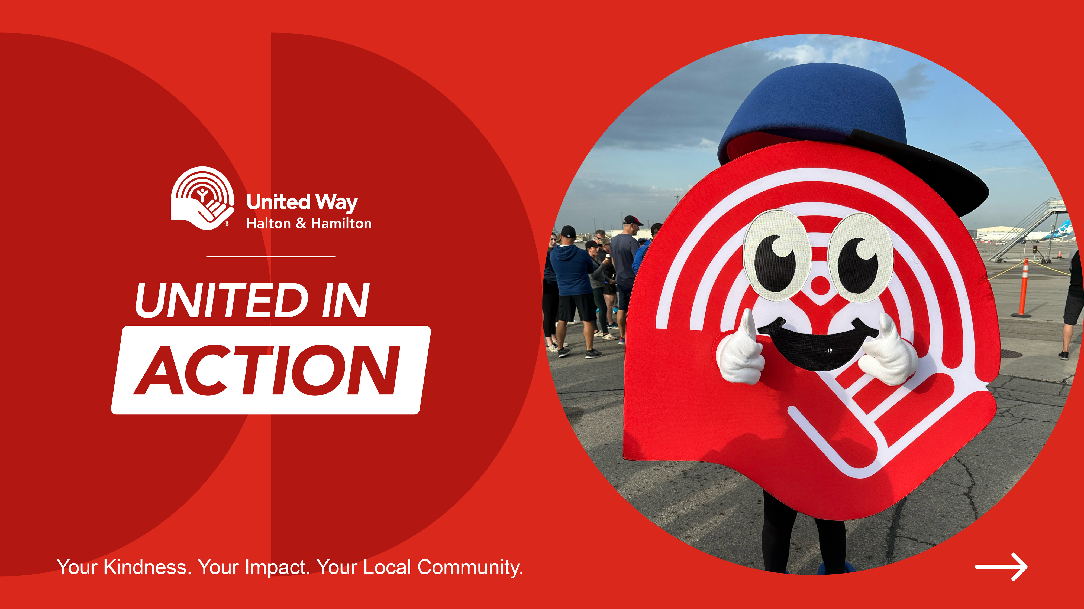
Notes:
Welcome, and thank you for joining today’s session.
We’re excited to share more about United Way Halton & Hamilton and the incredible work happening through the 2025 to 2026 campaign.
During this session, we’ll cover:
Who United Way Halton & Hamilton is and the communities we serve
The critical challenges facing our region right now
How United Way is taking action to create real, lasting impact
How you can get involved and make a meaningful difference
This campaign is about more than just giving, it’s about standing united for our neighbours and helping create a stronger, more resilient community for all.
Let’s dive in and explore how we can be part of the change.

Slide 2

Our Mission
To improve lives, build community
and ignite action.
What is
United Way?
Every gift stays local. Every action matters.
Let’s stand together, United in ACTION.
Our Vision
To improve lives, build community
and ignite action.
Notes:
Today, we’re going to talk about how United Way Halton & Hamilton is responding to the most urgent issues facing our neighbours, and how you can be part of creating real, lasting impact.
Who We Are
United Way Halton & Hamilton brings people and resources together to support those in crisis, reduce systemic barriers, and build stronger, more resilient communities.
We are the second largest funder of social services in Canada, after government.
We take a local approach to complex issues, ensuring that supports are available when and where people need them most.
What We Do
Last year, we supported more than 226,500 individuals and families, that’s nearly 1 in 5 people across Halton and Hamilton.
We fund 76 agencies delivering 124 programs, across five local communities: Burlington, Halton Hills, Hamilton, Milton and Oakville.
Programs include:
Housing supports and food access
Mental health services and suicide prevention
Youth mentorship and educational supports
Senior wellness and caregiver respite
Supports for women, newcomers, and people living in poverty
Why United Way?
Reach: With a single donation, you’re supporting a wide network of programs designed to work together, delivering wraparound care.
Stability: We provide multi-year, stable funding to agencies, so they can plan ahead and focus on service, not just survival.
Value: We work hard to invest every dollar where it will make the greatest difference, guided by volunteer experts and local data.
Oversight: Our investments are shaped by volunteers, donors, and community members who know their neighbourhoods best.

Slide 3
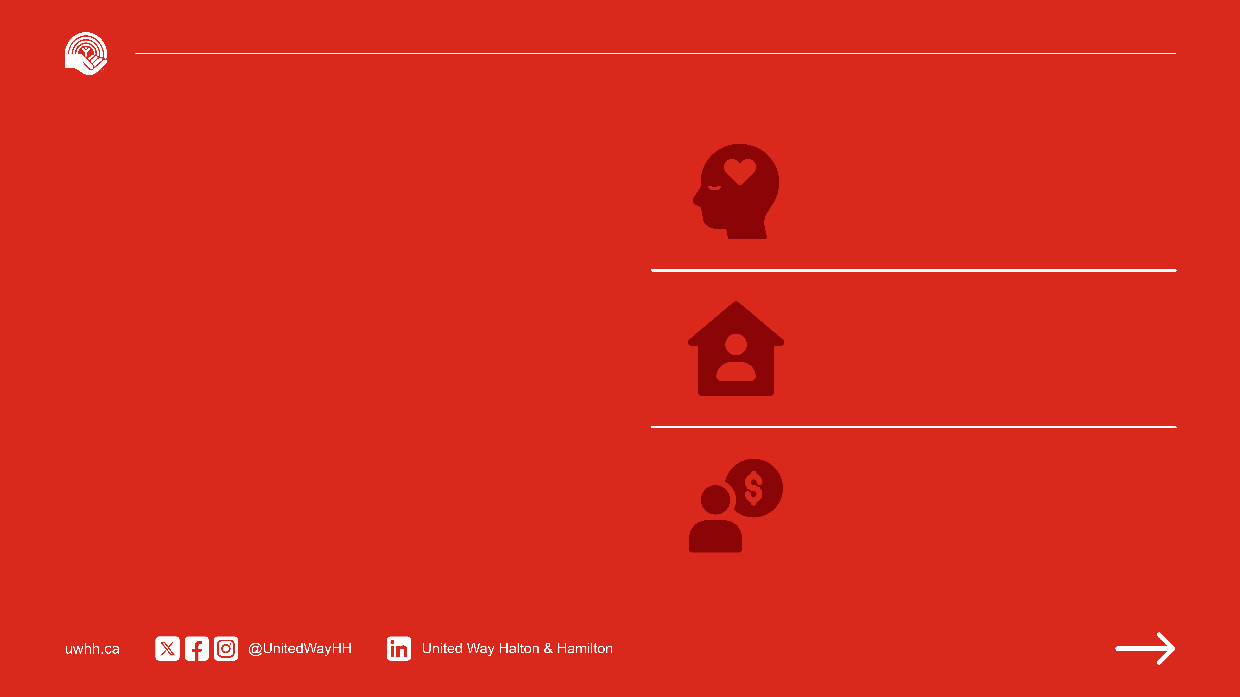
39% of Hamilton high school students want to talk to someone about a mental health or emotional concern but don’t know where to turn.
The Need in
Our Community
30% of Canadian seniors are at risk of social isolation - the top challenge identified by the International Federation on Ageing.
In Halton, the average person must earn $26/hour just to afford basic necessities - the rising cost of living is straining residents financially.
Notes:
The Need in Our Community – 2025–26
United Way Halton & Hamilton is focused on building a strong, supportive community where everyone can thrive.
Right now, ongoing economic pressures are making it harder for individuals and families to meet basic needs.
Social service agencies are stretched , and the data is clear:
70% of United Way-supported programs report rising demand
64% are managing more complex client needs (e.g., mental health, food insecurity)
50% now have waitlists
Through United Way’s 211 program, we know that the top issues experienced by community members in in Halton & Hamilton include:
Housing
Health and mental health
Substance use, legal, and safety concerns
Access to information and navigation support
United Way is focused on action - stabilizing programs, reducing barriers, and ensuring help is available when and where it’s needed most.
United in ACTION, we’re creating a future where everyone in our community has the support to move forward.

Slide 4
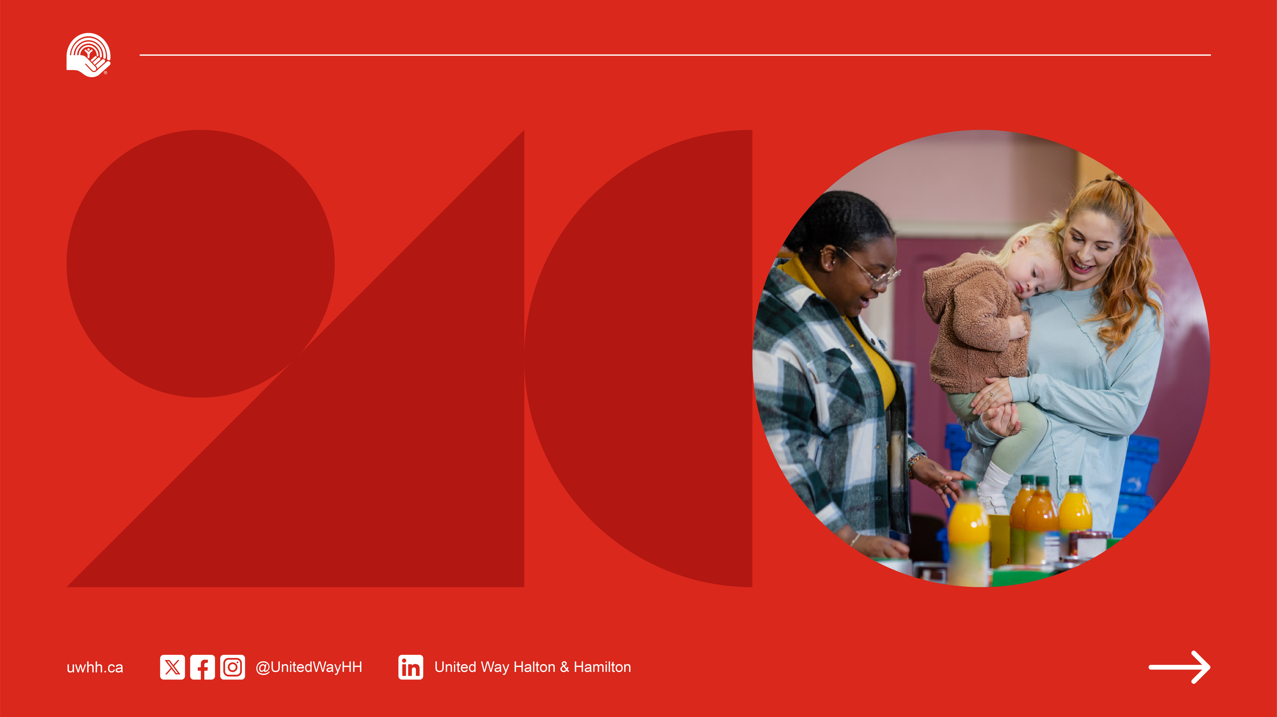
Network of Support in ACTION
When friends and neighbours in our community need support, they often rely on multiple services to navigate life’s challenges.
Notes:
United Way’s Network of Support
When people in our community reach out for help, they often need more than one kind of support, and that’s where United Way’s network of support comes in.
United Way serves as the backbone of this network, connecting people, programs, and partners to deliver holistic support where it’s needed most.
We bring together agency leaders, community experts, and donors to strengthen services, build leadership, and drive collective impact.
Through collaboration, United Way helps create integrated services that meet the unique and complex needs of local residents.
By investing in innovation and capacity-building for frontline agencies, United Way helps our community respond to challenges faster and more effectively.
This is what it means to be United in ACTION - working together to drive meaningful, lasting change.

Slide 5
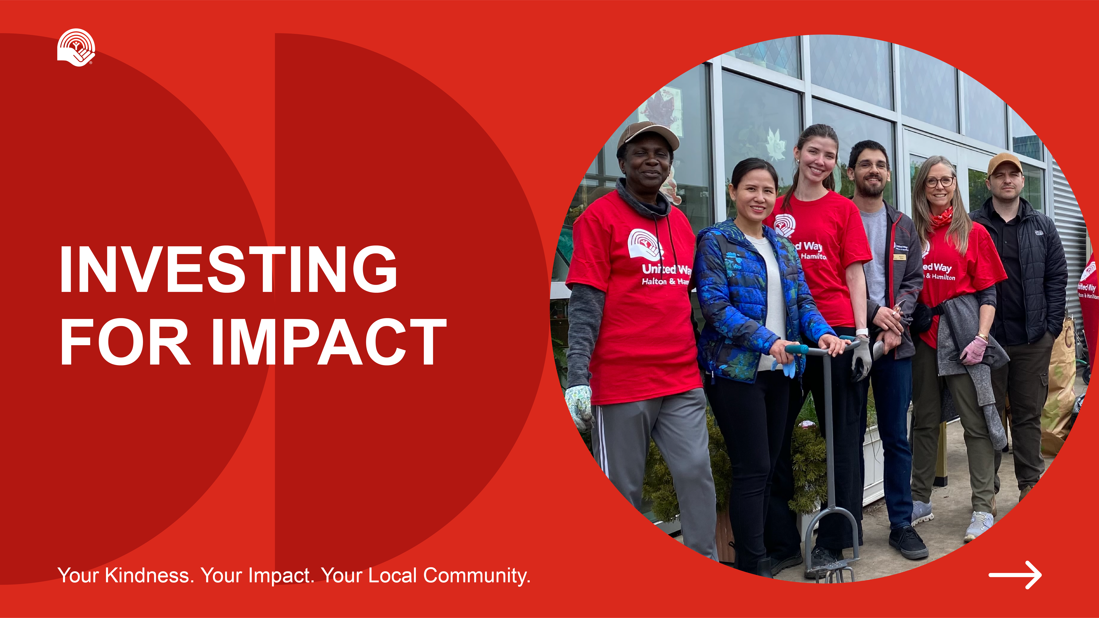

Slide 6
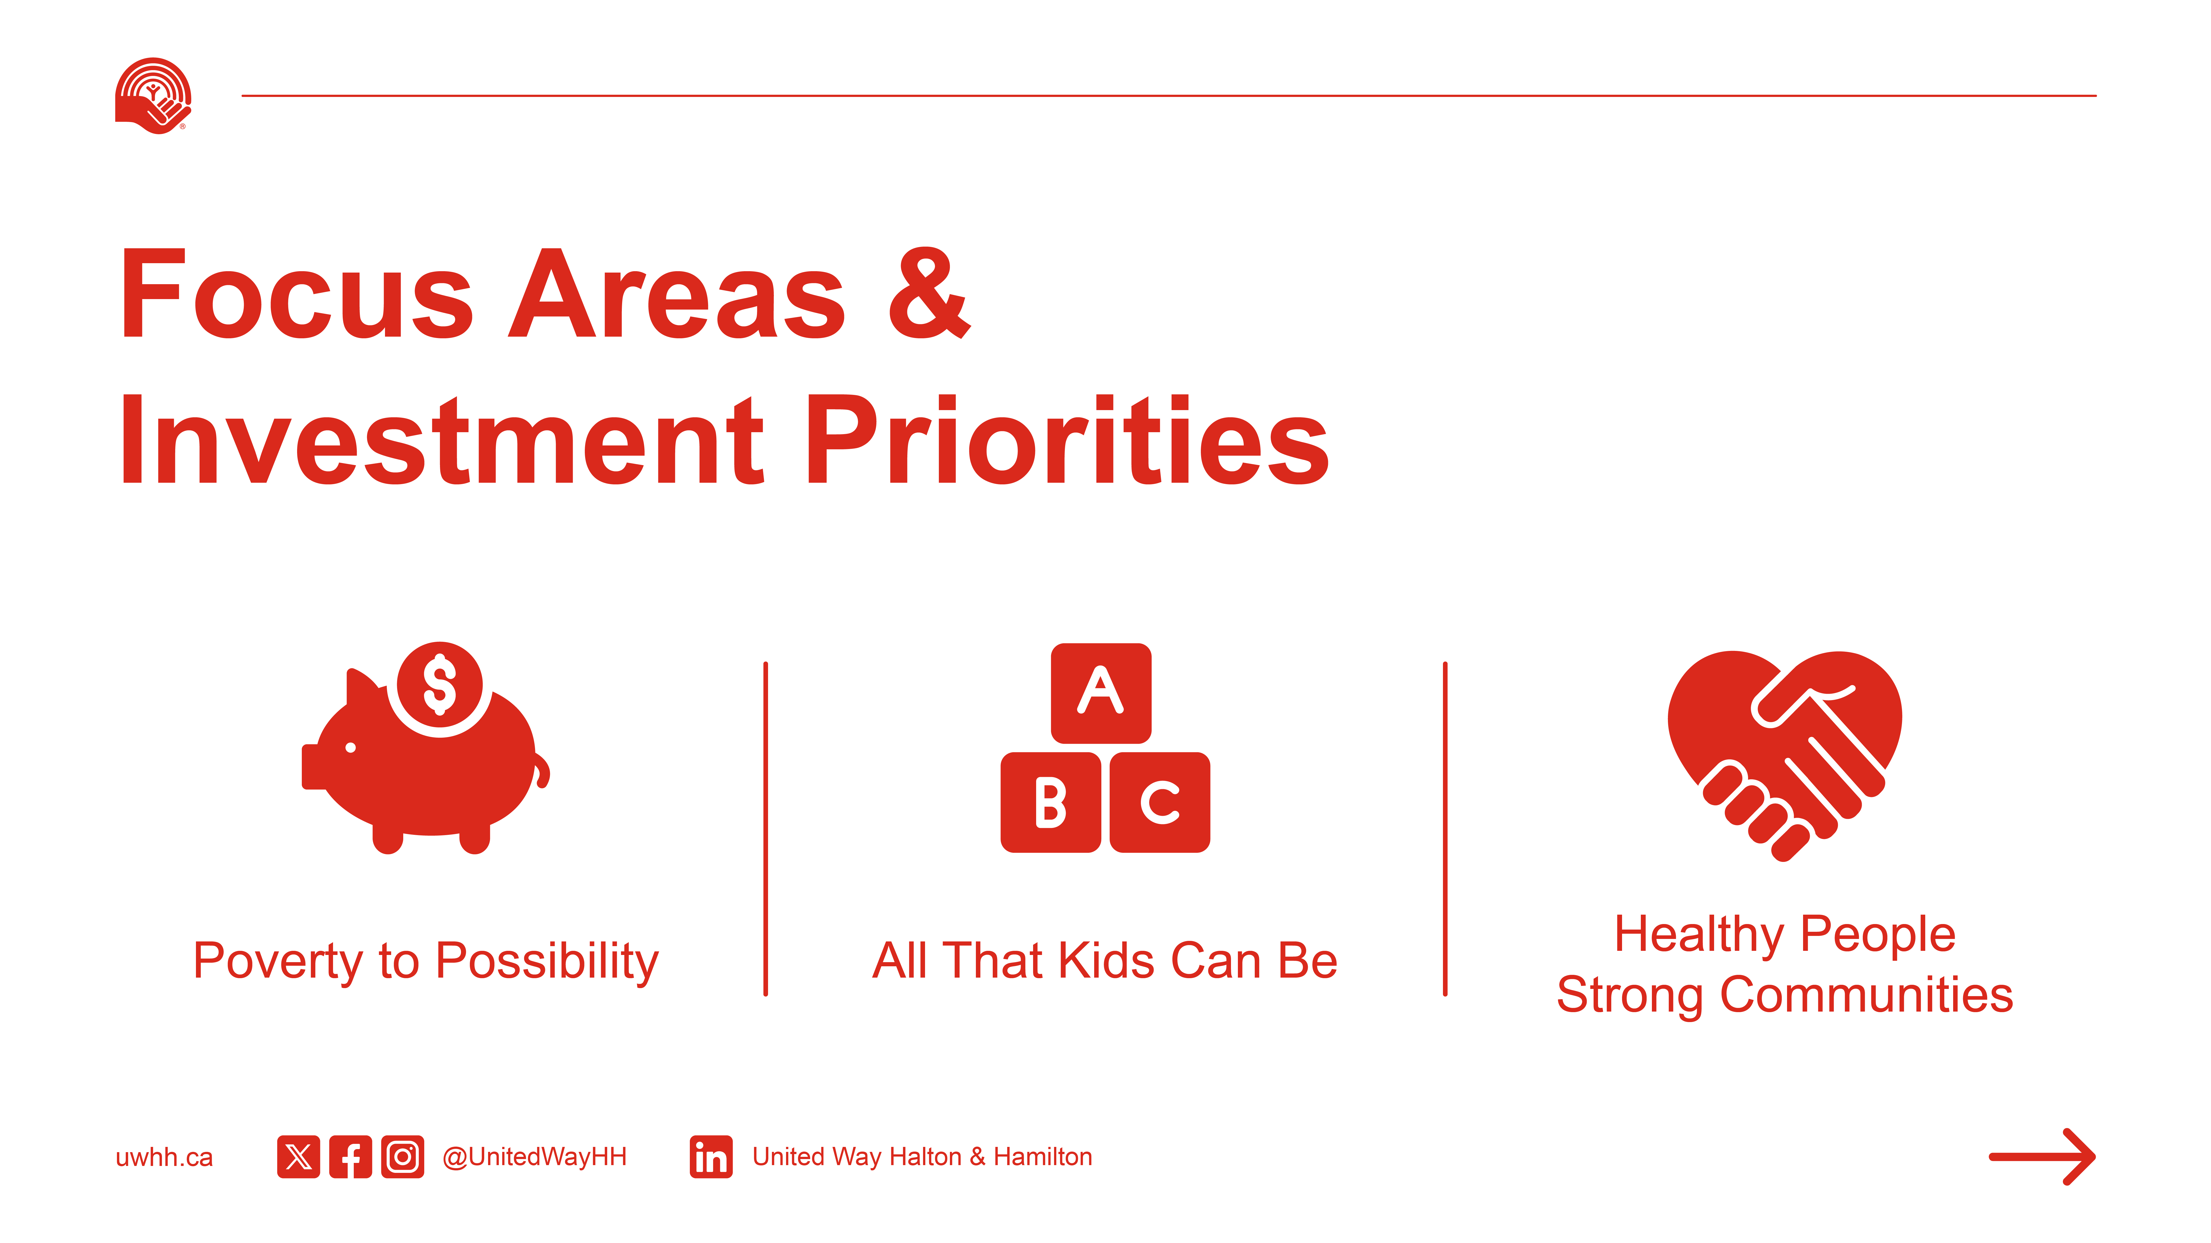
Notes:
United Way’s Investment Pillars
United Way Halton & Hamilton invests in solutions that tackle some of the most pressing and complex social issues facing our region.
Our work is focused across three key investment pillars:
Poverty to Possibility – Helping people meet their basic needs, find stable housing, build financial independence, and gain access to employment opportunities.
All That Kids Can Be – Supporting children and youth through mentorship, mental health services, school-based programs, and resources that help them reach their full potential.
Healthy People, Strong Communities – Creating safe, inclusive communities by investing in mental health supports, senior care, newcomer services, and programs that reduce social isolation.
These aren’t one-off solutions. They’re connected efforts that support people at every stage of life—from offering parenting support at local resource centres, to helping seniors feel valued and included, to making sure no one is left behind.
This approach ensures every gift goes to work where it’s needed most, building stronger communities and creating lasting change.

Slide 7
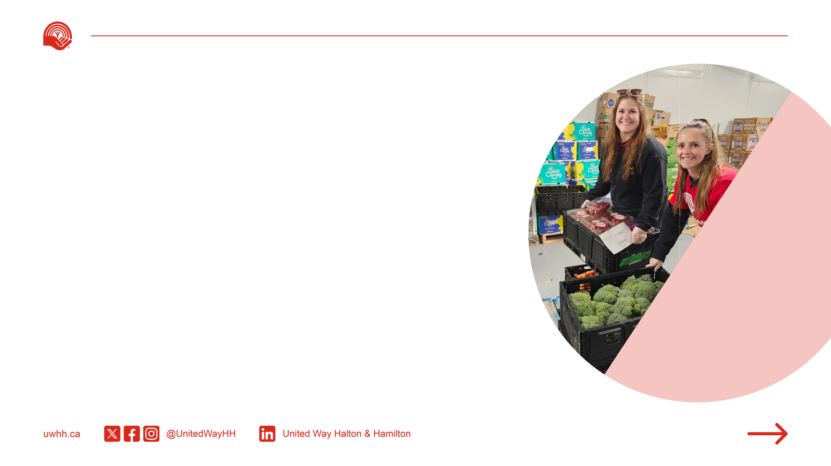
Poverty to Possibility
POVERTY IS A DEEPLY ROOTED CHALLENGE THAT AFFECTS EVERY ASPECT OF LIFE.
United in ACTION, we support local programs that help people gain economic independence, access affordable essentials, and build skills for a brighter future.
Notes:
Poverty to Possibility
Across Halton and Hamilton, affordability continues to be one of the most urgent and complex challenges facing individuals and families.
Soaring housing costs, inflation, and job insecurity are pushing more people to the edge. Many are having to make impossible choices between paying rent and buying groceries.
1 in 6 people in Hamilton now live in poverty, and in Halton, the number of individuals accessing food banks has increased by over 40% in just one year.
These pressures are felt most deeply by low-income families, newcomers, women-led households, and individuals with disabilities.
Through United Way’s investments in this area, your support helps ensure people can access food, shelter, employment services, financial literacy programs, and other vital supports to move toward stability and independence.
Thanks to your support last year:
43,149 people experienced increased food security
26,134 individuals worked toward financial stability
3,630 people were connected to employment training and skill-building opportunities
United Way Halton & Hamilton is not just responding to crisis, it’s helping people build pathways out of poverty. Together, we’re making long-term change possible.

Slide 8
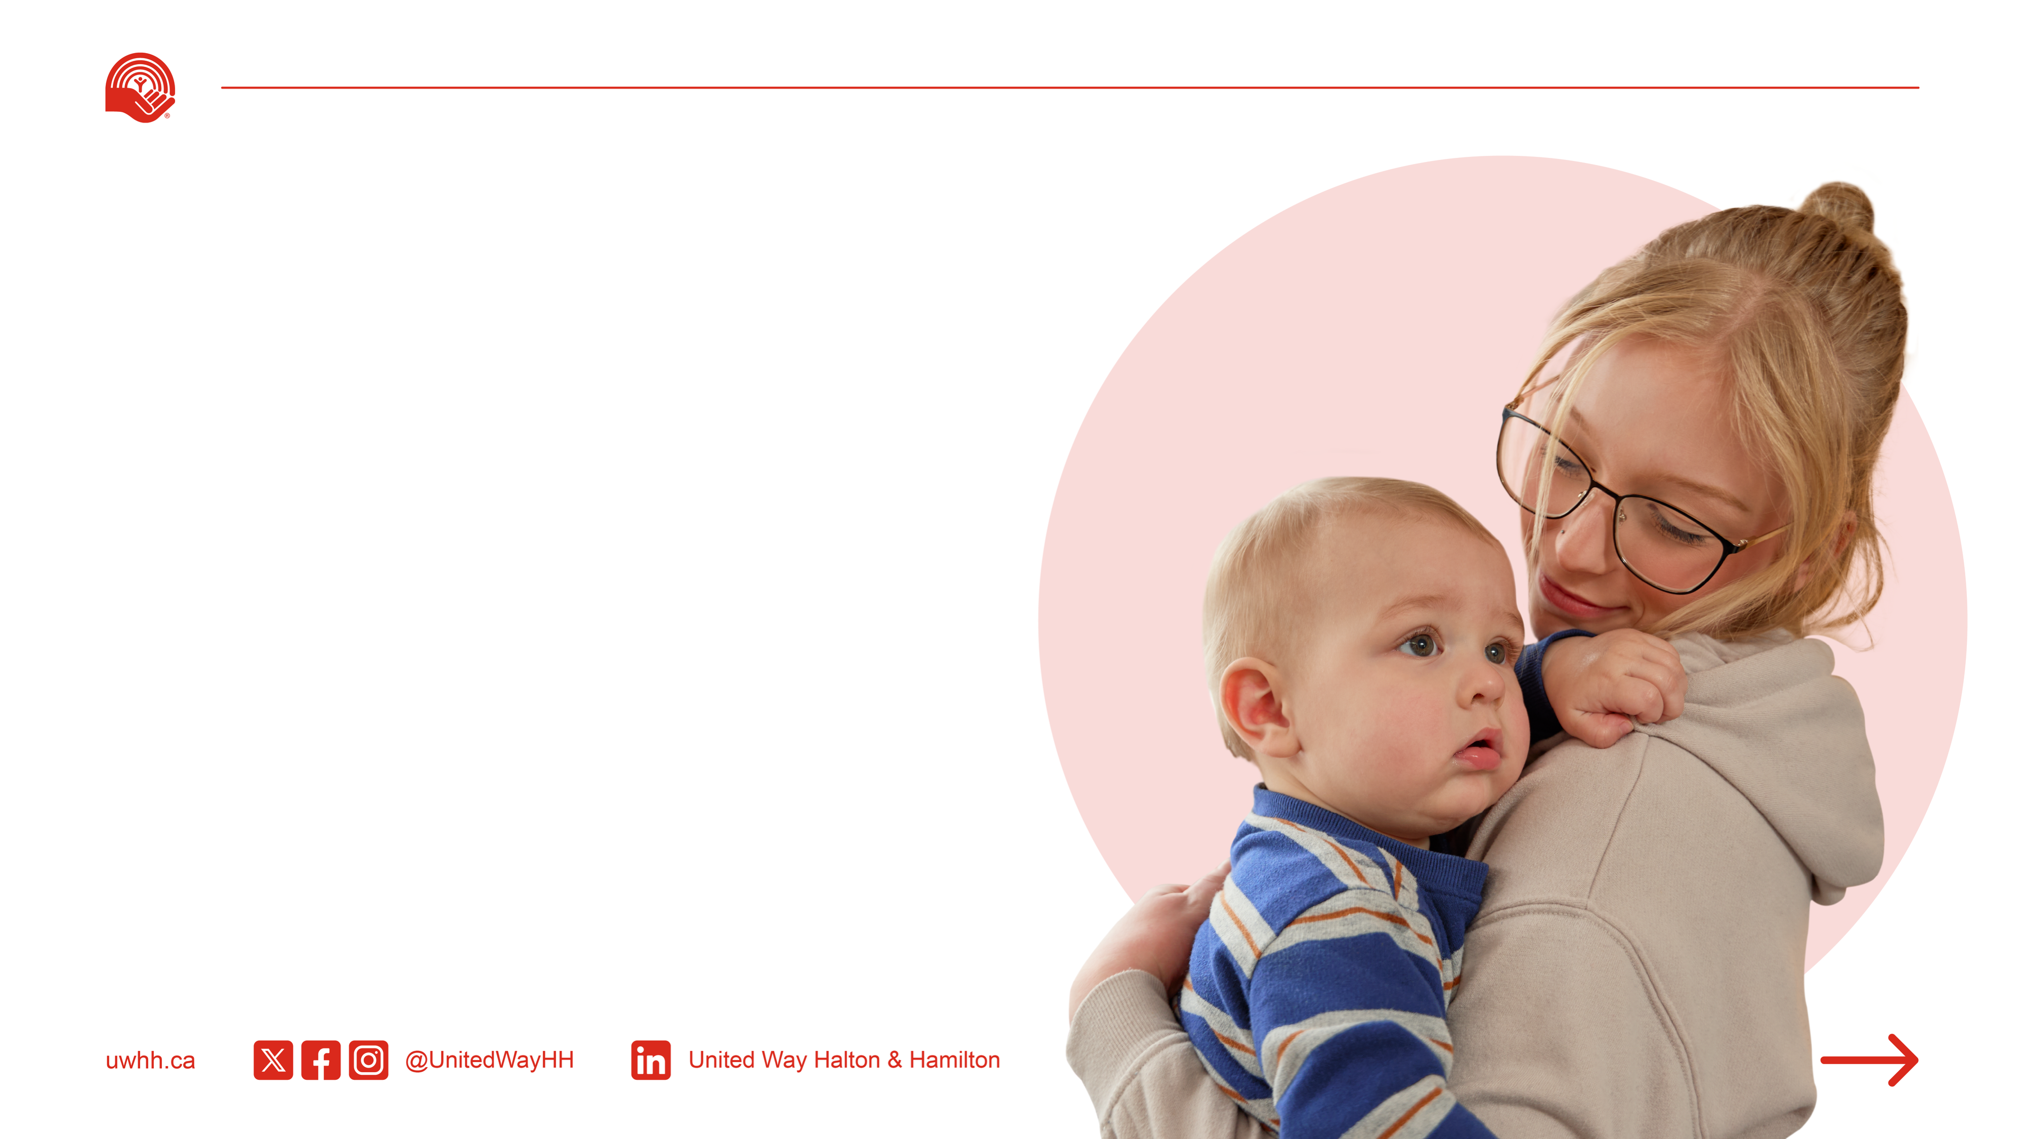

United Way’s support didn’t just give me a place to stay—they gave me hope, confidence, and the tools to build a future for me and my son.”
Watch Montanna’s Story
United in ACTION, we have helped 48,457 women who are facing systemic barriers to inclusion and prosperity.
Notes:
A powerful example of moving from poverty to possibility is Montanna’s story.
At just 18, Montanna was pregnant, alone, and had nowhere to turn. Without a safe place to stay or support system to lean on, she was referred to a United Way–supported residential program, one that became her lifeline.
Through this program, Montanna learned essential life skills, built a strong bond with her son Cain, and achieved milestones like finishing high school, earning her driver’s license, and being accepted into college.
Let’s take a moment to watch Montanna’s story.

Slide 9
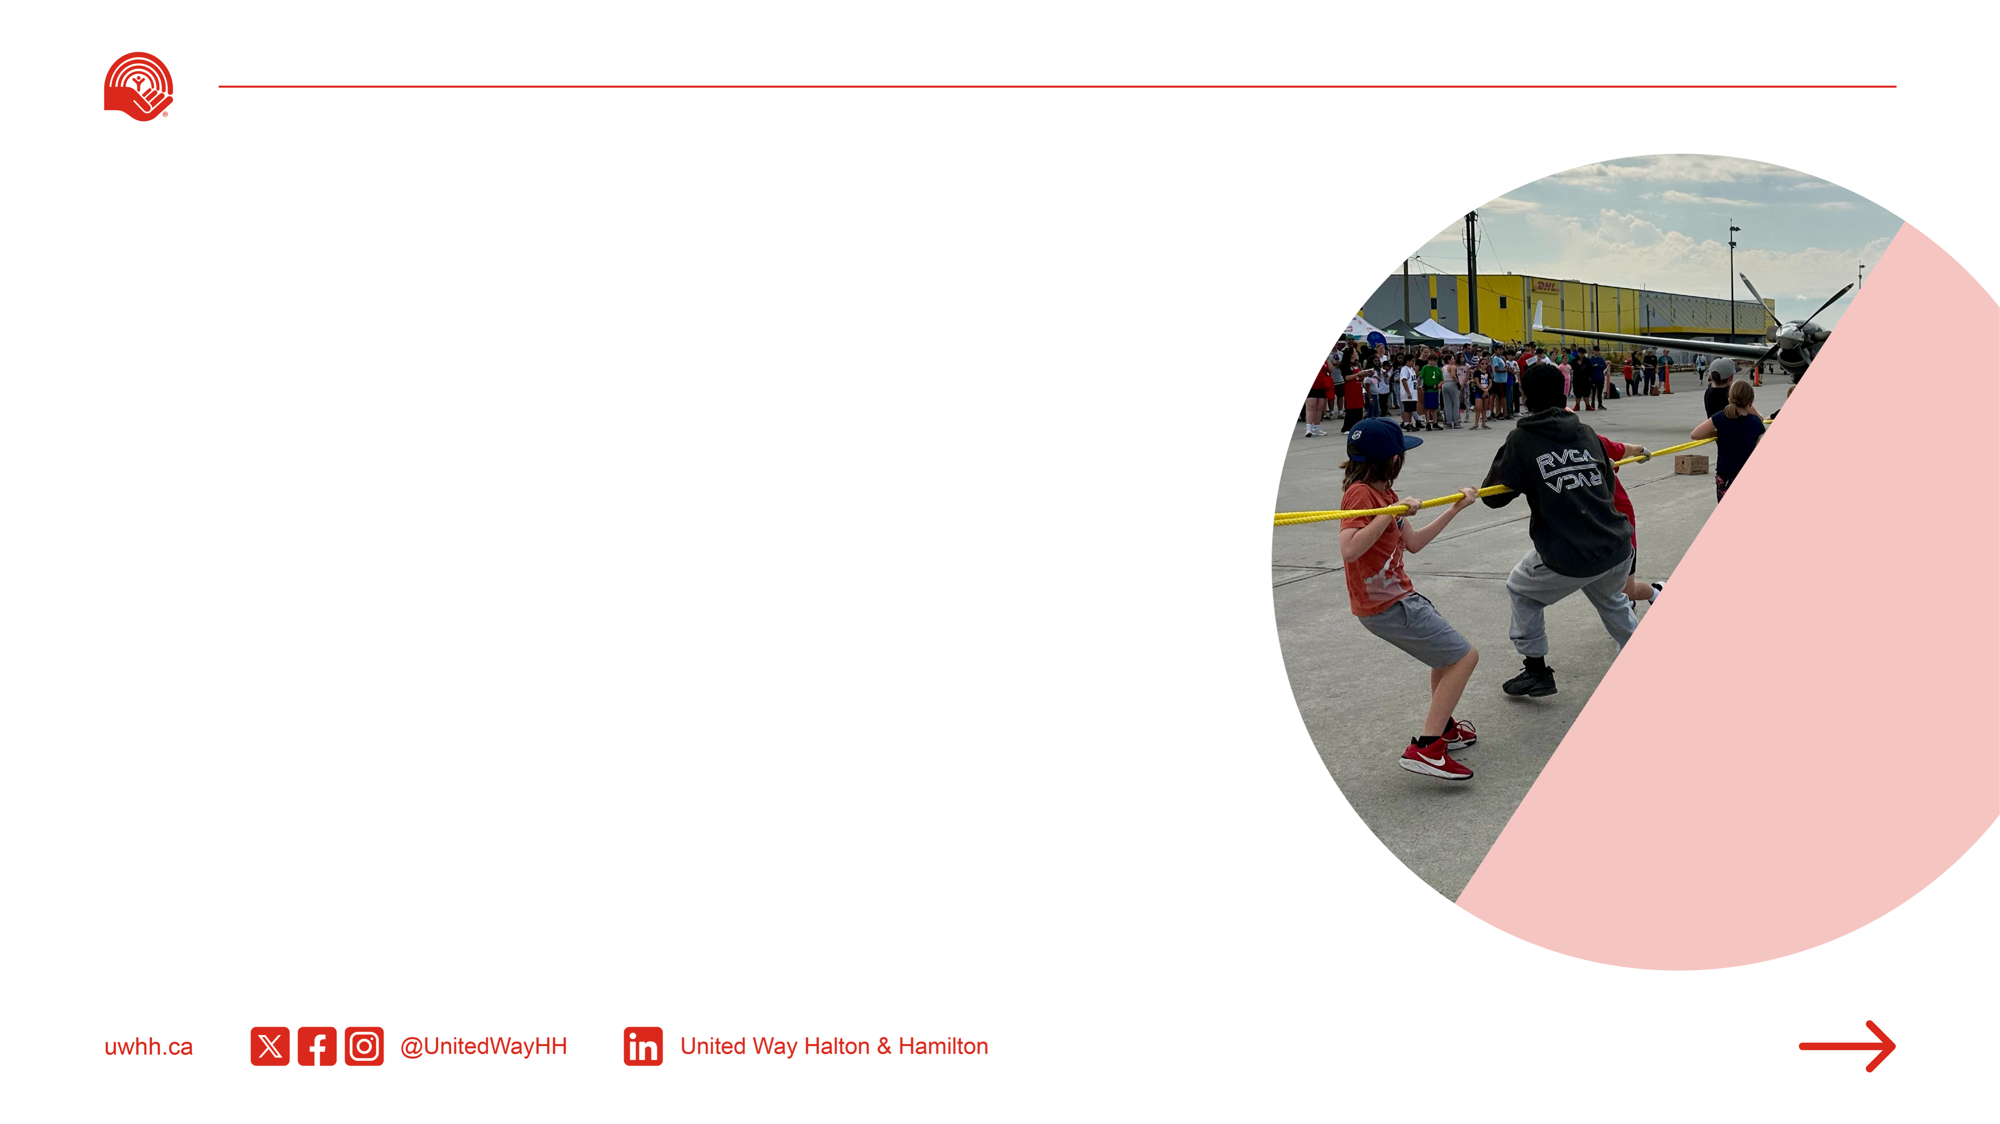
All That Kids Can Be
CHILDREN AND YOUTH FACE BARRIERS THAT CAN LIMIT THEIR DEVELOPMENT
AND POTENTIAL.
United in ACTION, we support programs that help them overcome challenges and thrive.
Notes:
All That Kids Can Be
Every child deserves the opportunity to thrive, but too many young people in Halton and Hamilton still lack access to the support they need.
United Way is focused on early interventions that prevent the long-term impacts of childhood adversity, including dropping out of school, mental health challenges, and poverty.
Thanks to your support, last year:
100,385 children and youth were connected to their community and experienced a stronger sense of belonging.
98,872 youth improved their emotional and physical well-being, building resilience for a brighter future.
18,520 families developed stronger engagement and capacity to support their children’s healthy development
Local programs help nurture academic success, build confidence, and improve mental health outcomes. These include:
After-school literacy programs
One-on-one mentorship
Parenting support
Mental health services tailored for youth
When we invest in youth today, we create the conditions for future success, in school, at work, and in life. Together, we are giving children and teens the foundation to reach their full potential.

Slide 10
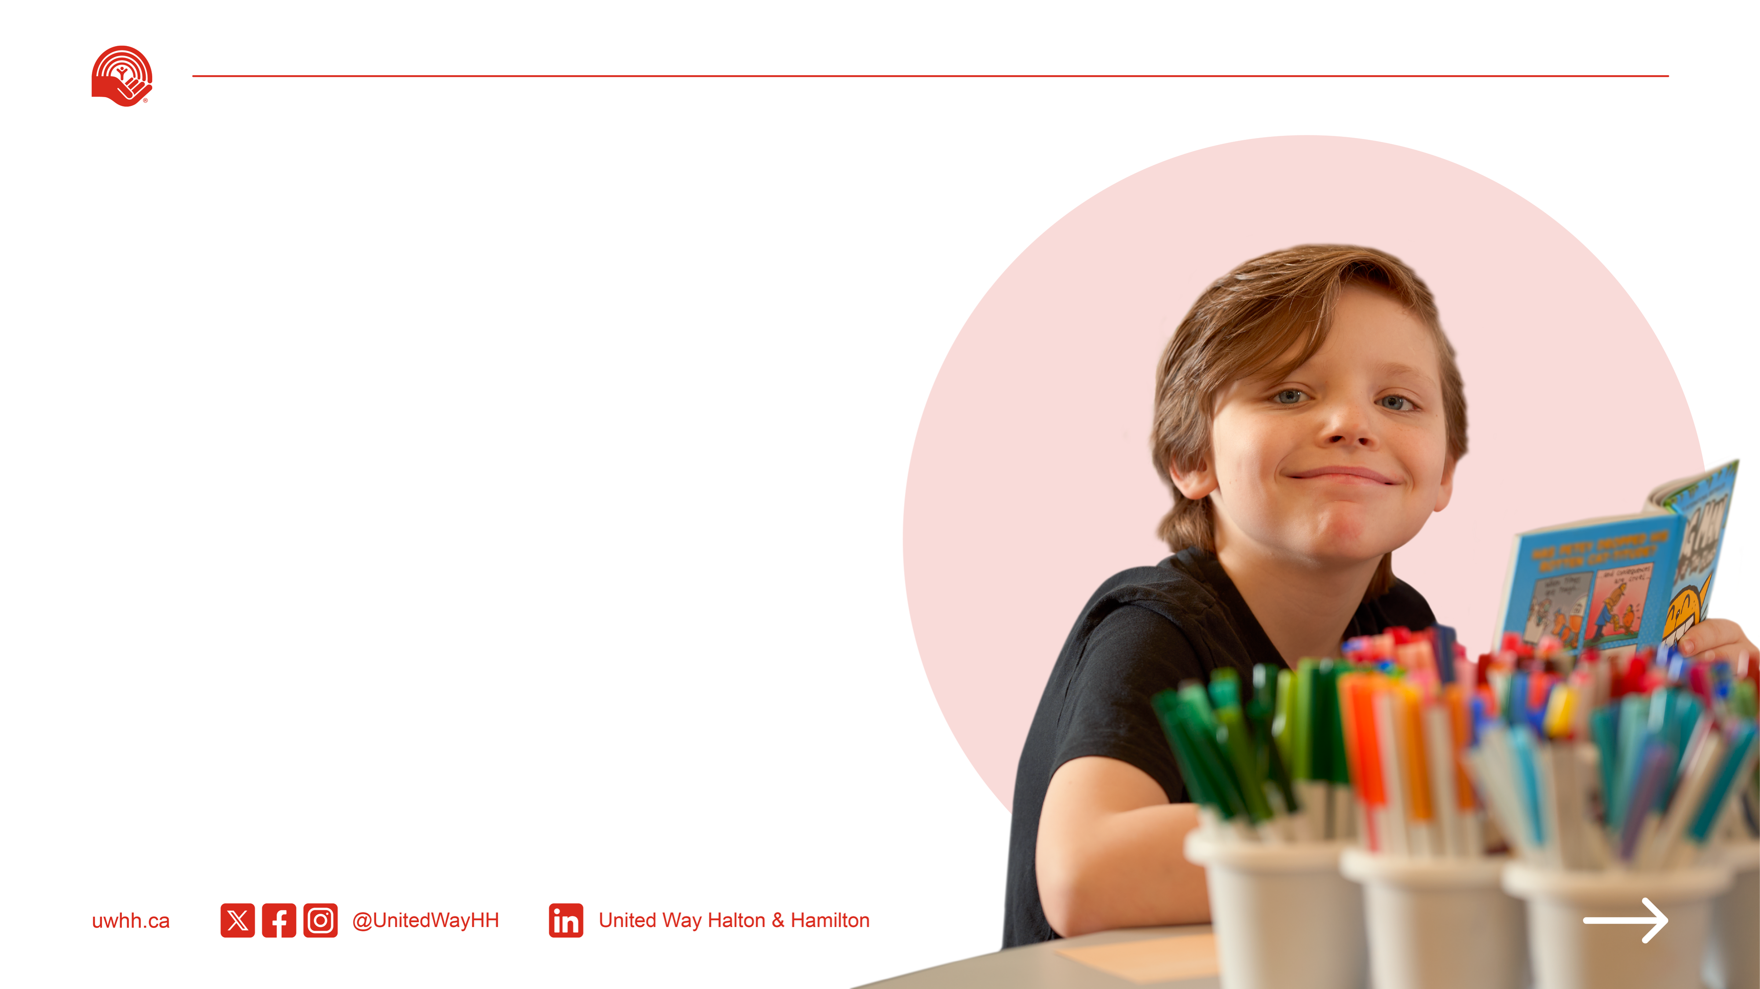
Thanks to United Way, Logan is learning to read
and gaining confidence every day. This program is helping him unlock his potential, and we’re so proud of his progress.”
Watch Logan’s Story
United in ACTION, we have helped 124,000 children and youth access basic needs and empowerment programs
Notes:
Making a difference in a child’s life creates a foundation for lifelong confidence, learning, and belonging.
From a young age, Logan struggled with reading and faced challenges that made school feel overwhelming.
After being diagnosed with borderline autism, he and his family found clarity, but also new worries about how he would succeed.
Thanks to a United Way-supported program, Logan received the one-on-one support he needed to grow, thrive, and believe in himself.
Let’s hear Logan’s story.

Slide 11
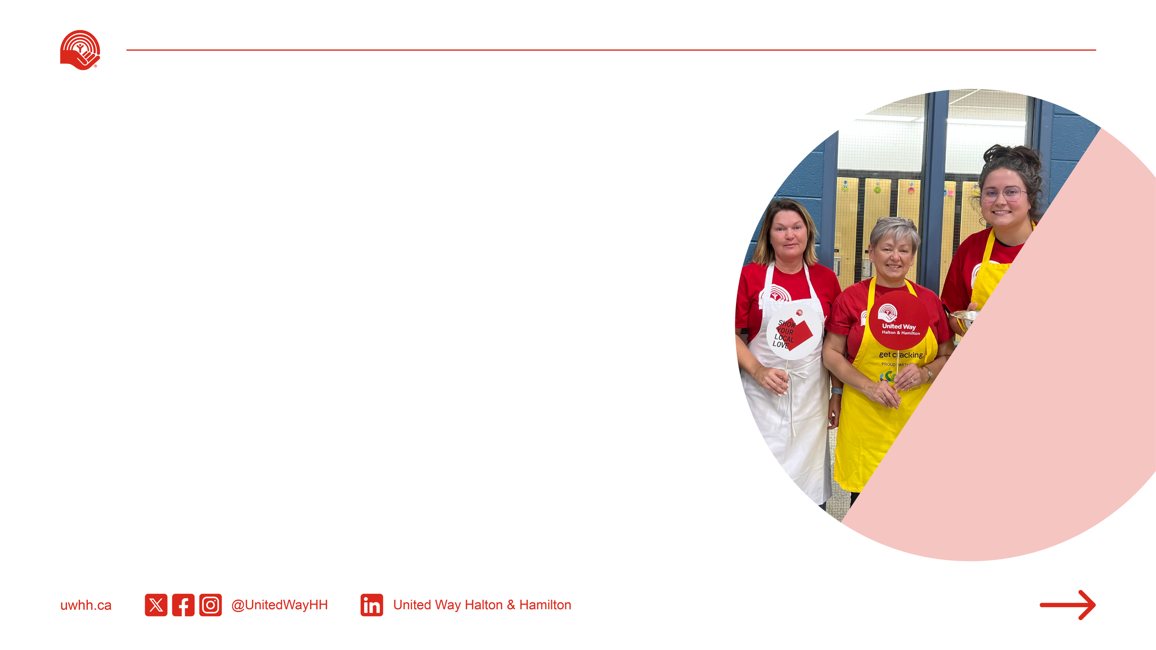
Healthy People
Strong Communities
WELLNESS AND BELONGING ARE THE FOUNDATION OF STRONG COMMUNITIES.
Communities are healthier when people feel safe, valued, and represented. United in ACTION, we support mental health, safety, and inclusion for all.
Notes:
Healthy People, Strong Communities
A healthy and safe community is one where everyone feels included, valued, and able to live with dignity. But too often, marginalized individuals, such as seniors, racialized communities, newcomers, 2SLGBTQIA+ individuals, people with disabilities or mental health challenges, and those living in poverty, face barriers that leave them feeling excluded or unsupported.
These barriers affect people’s ability to participate fully in their communities, access the help they need, or live healthy, meaningful lives.
The need is clear:
More than 40% of Canadians feel lonely some or all of the time, with those living alone most affected
The economic burden of mental illness in Canada exceeds $51 billion annually
In Hamilton, 59% of immigrants and visible minorities have experienced discrimination in the past three years
Thanks to your support, United Way Halton & Hamilton made a meaningful difference last year:
75,392 people improved their mental health and ability to cope with life’s challenges
54,661 people felt more included and connected to their community
35,346 racialized individuals were supported through culturally relevant programs that promoted equity and inclusion
Together, we are building stronger, more compassionate communities where everyone has the chance to feel safe, supported, and connected.

Slide 12
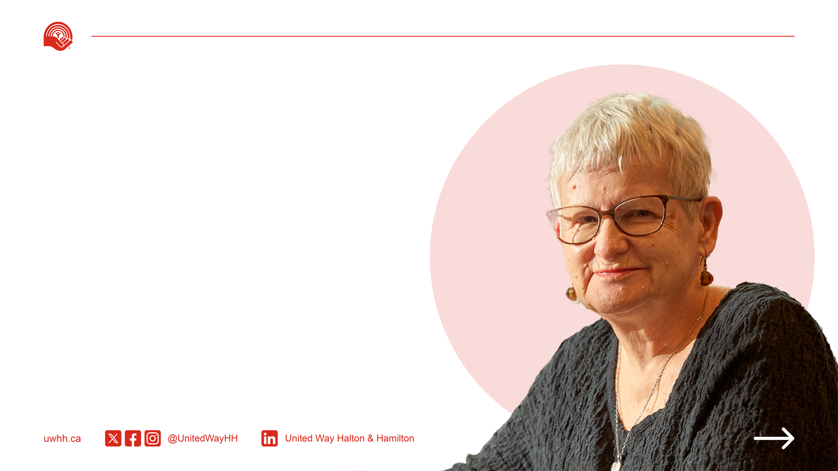
United Way’s support didn’t just help my husband - it helped me, as a caregiver, find strength and peace during one of the hardest journeys of my life.”
Watch Carol’s Story
United in ACTION, we have helped 50,224 seniors improve their wellness and sense of belonging.
Notes:
Many seniors in our community face grief, isolation, and emotional hardship, especially after losing a loved one. This was the case for Carol.
After her husband Don passed away from dementia, Carol struggled with loneliness and sadness. But through a United Way-supported grief support program, she found comfort, connection, and a path to healing.
Carol calls the group “a lifeline”, a place where she felt seen, supported, and understood.
Her story reminds us that no one should have to face grief alone, and that your support makes this healing possible.
Let’s hear Carol’s story.

Slide 13
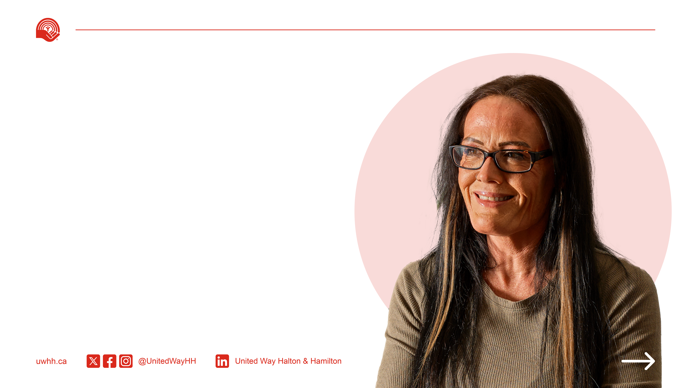
Without United Way, I wouldn’t be alive today. United Way saves lives on levels that people aren’t even aware of. Every dollar donated to United Way goes to help someone like me.”
Watch Heather’s Story
United in ACTION, we've helped 86,066 people strengthen their mental health and better cope with life’s challenges.
Notes:
At one point in her life, Heather didn’t think she’d live to see another day.
Struggling with addiction, she was alone and afraid, until she connected with a United Way-supported agency that offered her the care, stability, and hope she so desperately needed.
Today, Heather is not only in recovery, she works at that same agency, helping others find their path forward.
Her story is one of resilience, healing, and full-circle transformation.
Let’s hear from Heather.

Slide 14
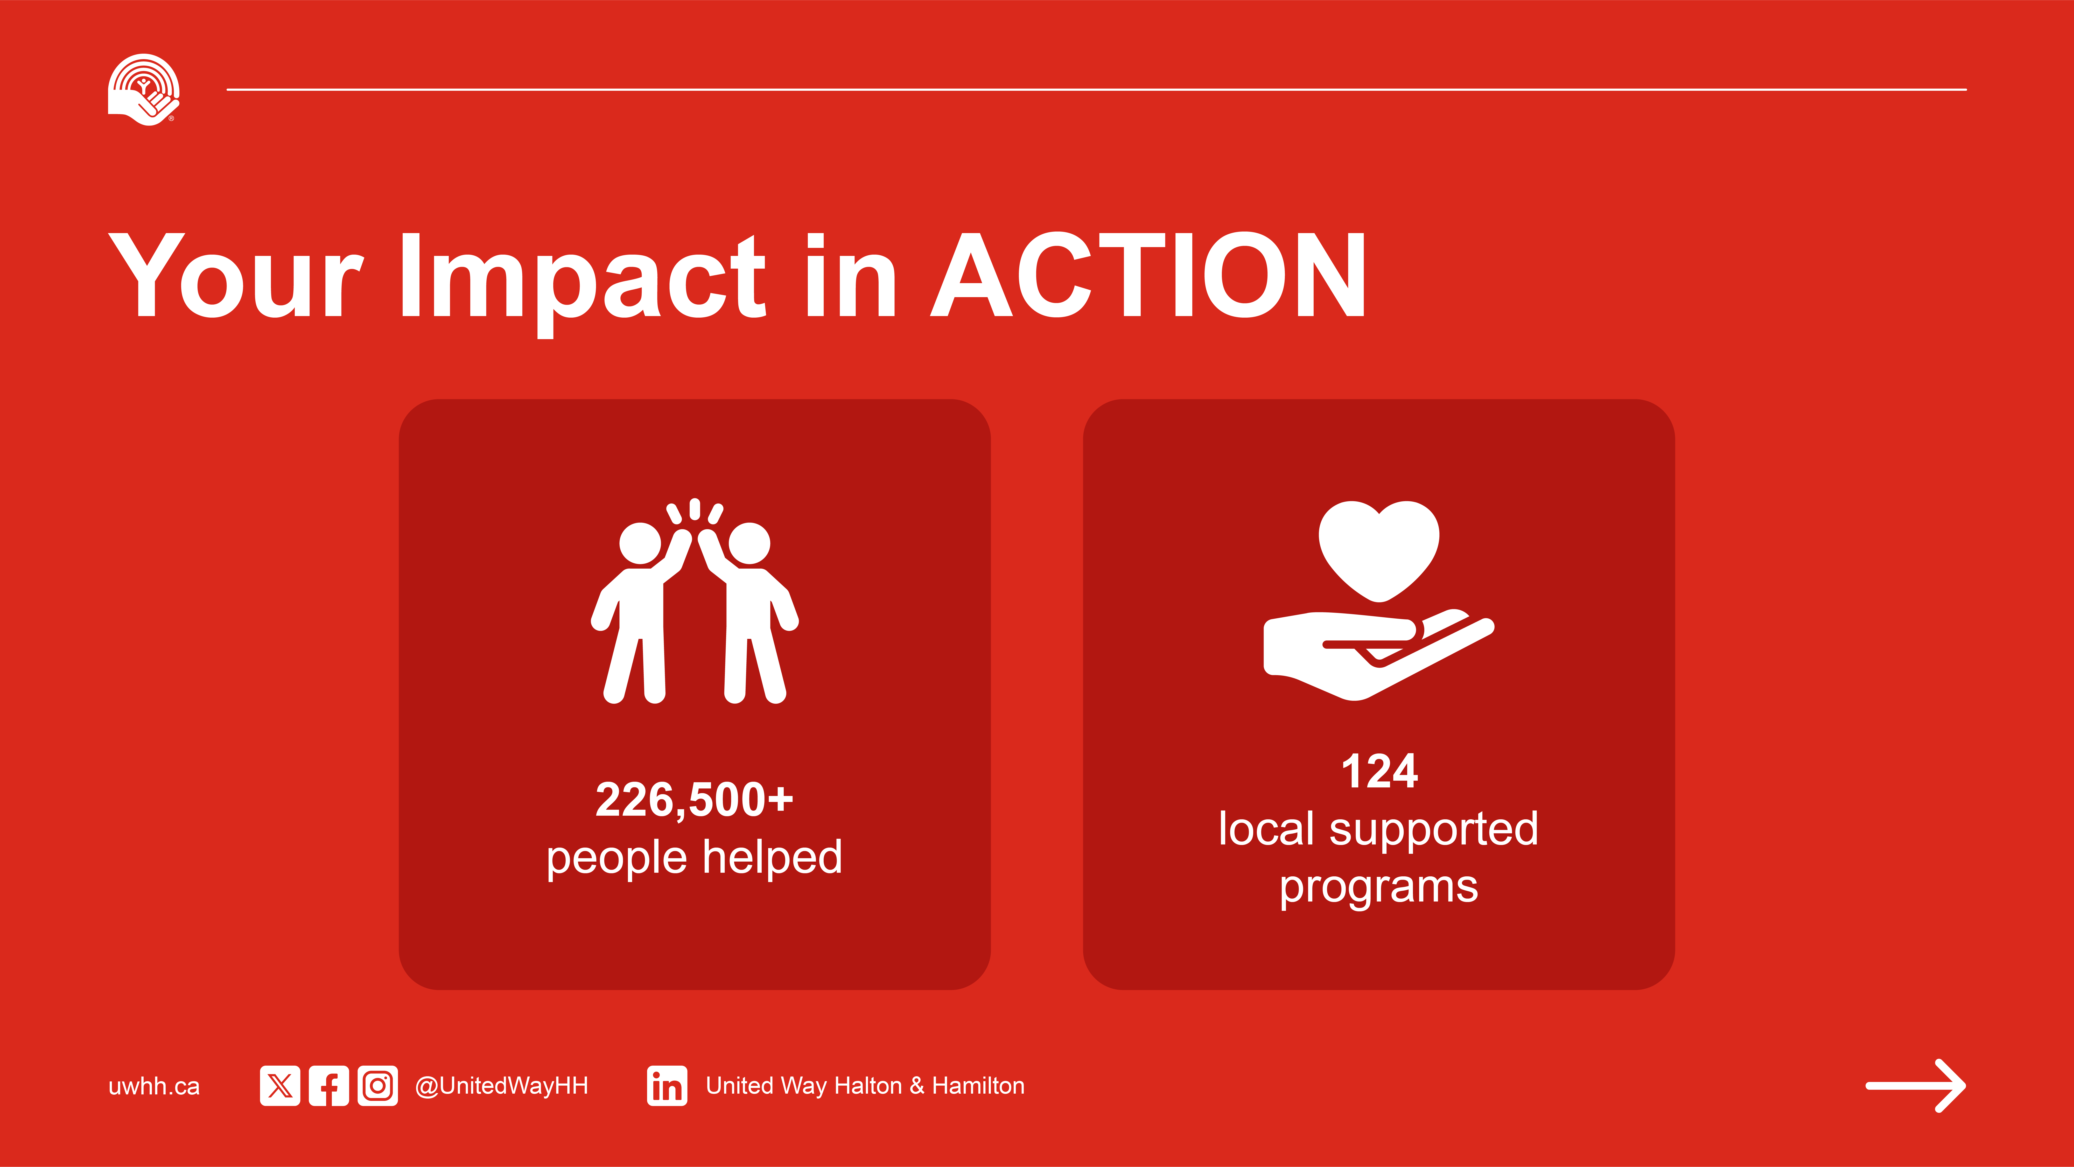
Notes:
United Way Halton & Hamilton is about more than charity, it’s about creating meaningful, lasting change right here where we live. Because for a community to be great, it has to be great for everyone.
Together with our network of agency partners, local government, community leaders, and thousands of generous donors like you, United Way is helping individuals and families across Halton and Hamilton overcome urgent challenges and build brighter futures.
In 2024–2025, thanks to your generosity, United Way supported an incredible 226,520 individuals and families across our region. That’s nearly 1 in 5 residents in Halton and Hamilton who received the help they needed, when they needed it most.
Through 124 programs delivered by 76 trusted agency partners, we’re tackling complex social issues, like poverty, homelessness, mental health, and youth isolation, and providing people with the tools to not only survive, but thrive.

Slide 15
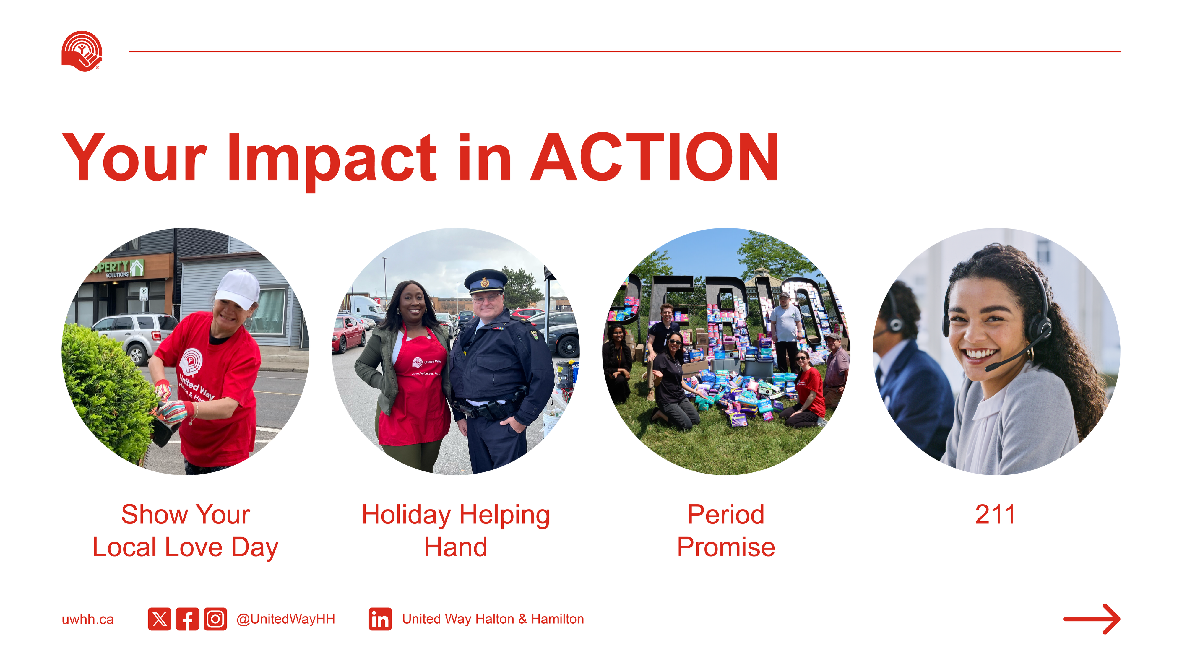
Notes:
United Way Programs & Initiatives – 2024–2025
In addition to being the largest non-government funder of social services in our region, United Way Halton & Hamilton also leads several innovative programs that further support our community:
Community Donation Warehouse: Through partnerships with corporations, logistics providers, and local agencies, United Way operates a donation warehouse that redistributes brand-new goods- everything from hygiene supplies to bedding- to agencies and their clients. In 2024–2025, nearly $430,000 in in-kind goods were distributed, providing relief and stability to thousands of individuals and families.
ConnectED: This capacity-building program provides accessible, affordable training to nonprofit professionals. More than 750 individuals participated last year, gaining skills in areas such as governance, leadership, evaluation, and financial sustainability, all essential for a strong social sector.
Labour Community Advocate Program: In collaboration with local unions, this training program equips union members with tools to help their colleagues access community resources. Graduates become vital advocates in their workplaces, supporting mental health, housing, and more.
Period Promise: This campaign tackles menstrual equity head-on. Last year, more than $75,000 in menstrual products were distributed, and growing numbers of businesses, municipalities, and organizations have pledged to provide free access to these essential items.
Show Your Local Love Day: A single-day volunteer blitz that mobilizes individuals and workplace teams to complete community projects, from painting and organizing to assembling care kits. In 2025, hundreds of volunteers took part, helping agencies stay focused on frontline service delivery.
Holiday Helping Hand: This seasonal program supported over 1,100 people last year through gift and essential drives. From adopting families to donating warm winter gear, it’s a tangible way to spread joy during a tough season.
Natural Supports Simulation: This interactive learning tool helps participants explore the informal networks that support those in crisis. It reinforces the importance of connection, empathy, and practical help, elements central to United Way’s philosophy.
Each of these programs complements the organization’s funding model and directly strengthens the social safety net in Halton and Hamilton.

Slide 16
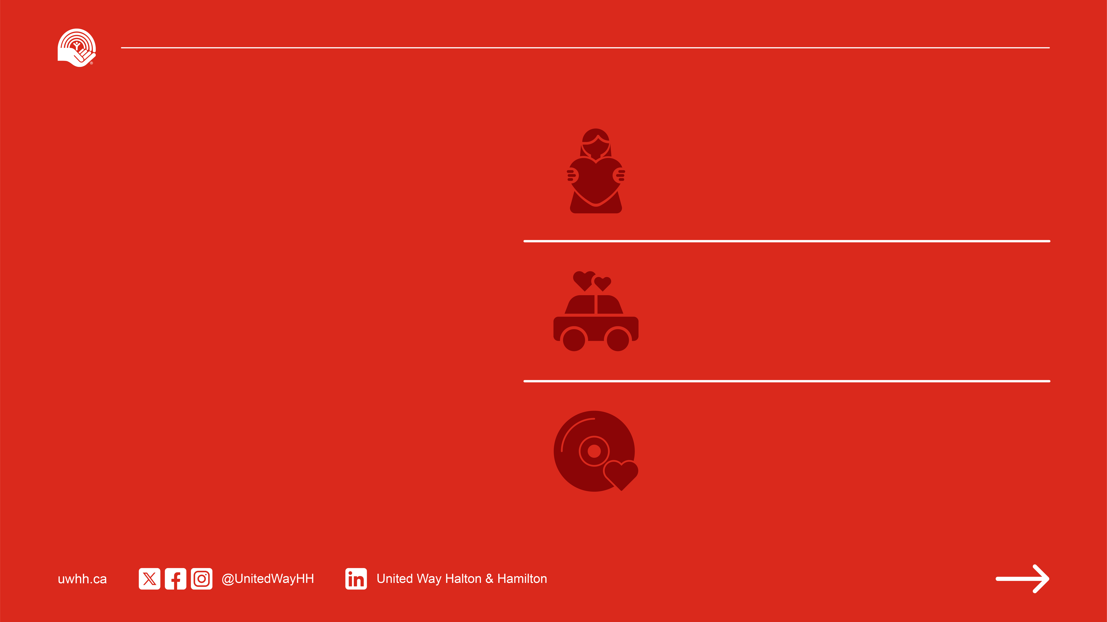
$5/pay
provides health and wellness programming to 9 women experiencing poverty
Your Gift
in ACTION
$14/pay
provides transportation to important medical appointments to 20 rural area seniors
$46/pay ​​(Leadership Gift)
provides weekly music classes to 143 people with developmental disabilities in residential homes for 3 months
Notes:
When you give to United Way Halton & Hamilton, your single gift does more than support just one program, it fuels an entire network of support across our community.
Your donation is invested strategically in 124 programs delivered by 76 local agencies, all working together to tackle the most pressing issues facing individuals and families.
Whether someone is struggling with housing, food insecurity, mental health, job loss, or senior isolation, your gift helps ensure there's a program available to meet them where they are.

Slide 17

Local Leaders
in ACTION
Benefits Include:
Early updates & impact reports
Invitations to exclusive events
One-on-one connection with a United Way team member
Recognition on the Leadership
Honour Roll
Valuable tax benefits
Join a powerful local network today!
BECOME A LEADERSHIP DONOR
Give $100+/month or $1,200+ annually to drive change and support programs local families, seniors, and kids rely on.
Notes:
Leadership donors are the driving force behind so much of the change happening in our community.
By giving $1,200 annually, or just $100 a month, you’re helping fund the vital programs that local families, seniors, and kids rely on every single day.
You’re helping people move from crisis to stability, from surviving to thriving.
As a Leadership donor, you also become part of a powerful local network, and there are meaningful benefits:
• You’ll receive early updates and detailed impact reports
• Invitations to exclusive United Way events
• A one-on-one connection with a United Way team member
• Recognition on the Leadership Honour Roll
• And, of course, valuable tax benefits
But more than anything, your gift creates real, lasting impact right here at home.

Slide 18
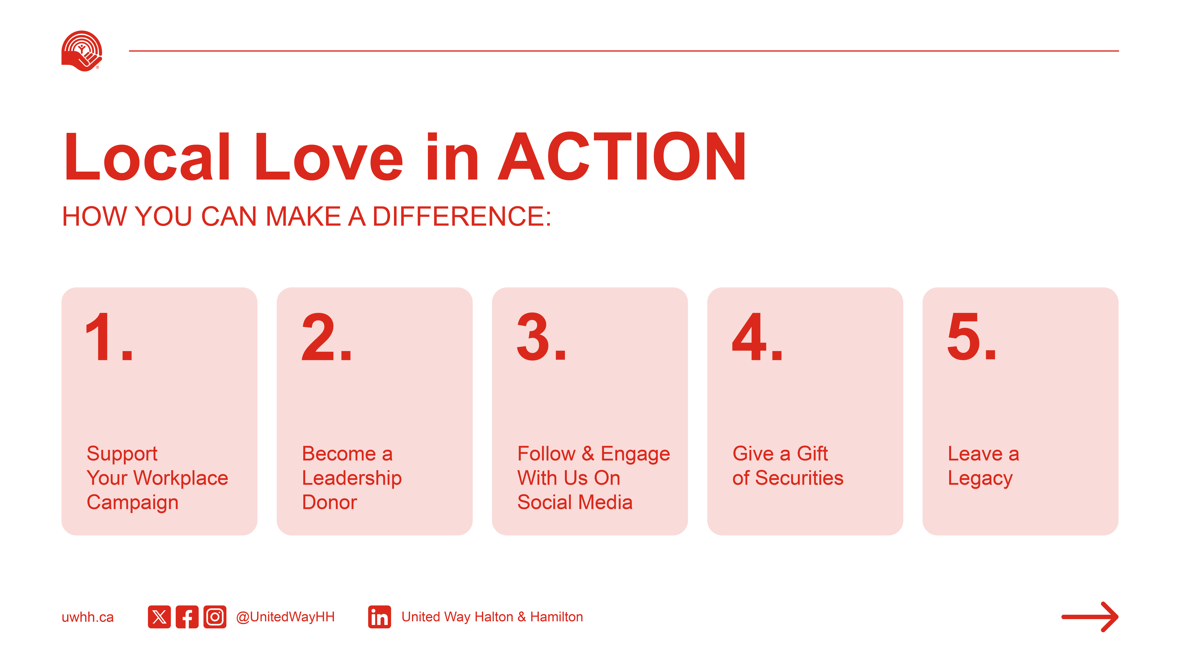
Notes:
There are many meaningful ways to give back—and every single one helps strengthen our community.
Support your workplace campaign: Giving through payroll or participating in your company’s campaign is one of the easiest and most powerful ways to give. Encourage your colleagues to join you—together, your impact multiplies.
Become a Leadership Donor: With a gift of only 1,200 or more, you join a network of donors who are driving large-scale change across Halton and Hamilton. You’ll receive recognition, updates, and exclusive opportunities to see your impact in action.
Volunteer or engage online: From Day of Caring projects to seasonal events and committee work, there are many ways to get involved. Visit uwhh.ca to find upcoming opportunities that match your interests and schedule.
Give a gift of securities: Donating publicly traded shares is the most tax-effective way to give. You’ll receive a charitable tax receipt for the full market value and avoid paying capital gains tax.
Leave a legacy: A gift in your will supports local programs well into the future. It’s a powerful way to reflect your values and leave a lasting mark on your community.
No matter how you choose to give, know this—your support creates stability and opportunity for those who need it most.

Slide 19

Now more than ever, our community needs us.
United in ACTION, we stand together so no one is left behind.
Notes:
Thank you so much for spending time with us today.
Your support inspires action, fuels change, and helps make our community an even better place to live, work, and play.
Together, we’re building a more inclusive, resilient future, where everyone has the opportunity to thrive.

Slide 20
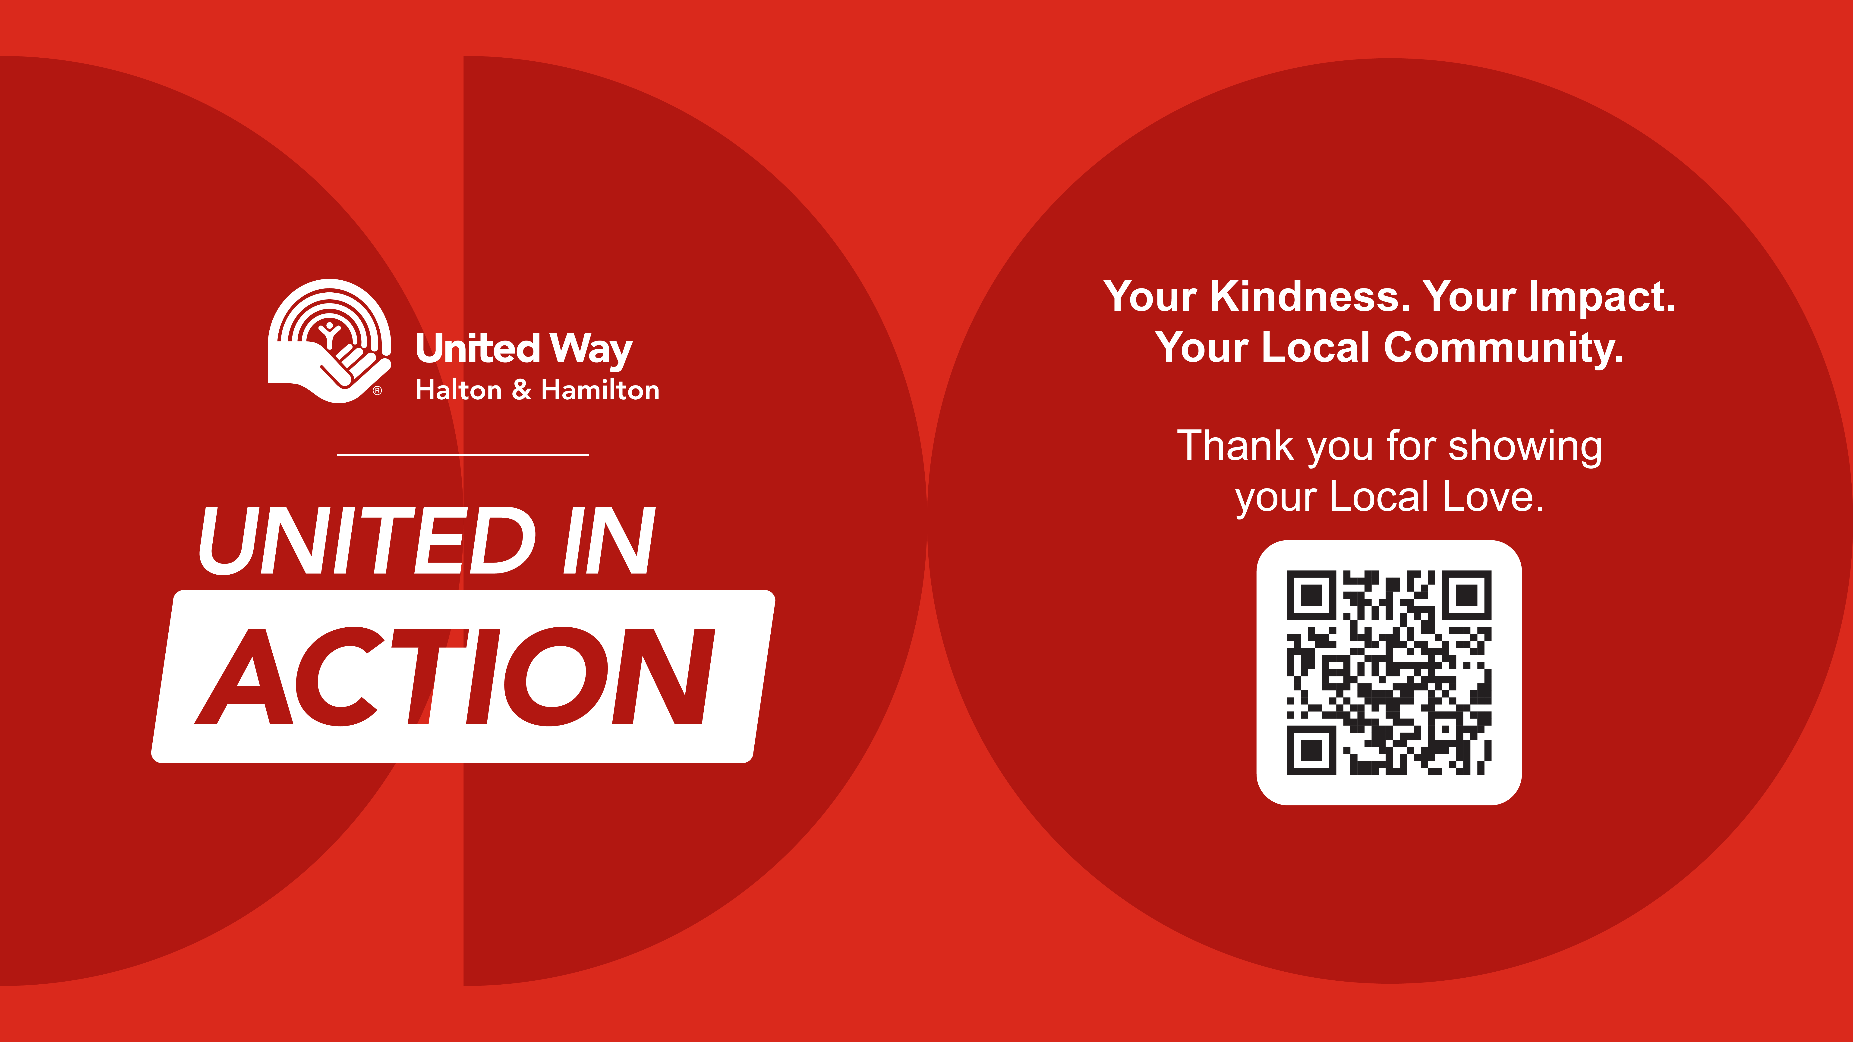
Notes:
United in ACTION, we can lift each other up.
I’d be happy to answer any questions you may have.

Slide 21

This is your
Title Copy
THIS IS YOUR SUB HEAD COPY
This is your body copy.

Slide 22

This is your
Title Copy
THIS IS YOUR SUB HEAD COPY
This is your body copy.

Slide 23

This is your
Title Copy
THIS IS YOUR SUB HEAD COPY
This is your body copy.

Slide 24

This is your sub-head copy
This is your body copy.
This is your
Title Copy
THIS IS YOUR HEADING COPY
This is your sub-head copy
This is your body copy.
This is your body copy.

Slide 25
This is your
Title Copy
This is your sub-head copy
This is your body copy.
This is a bullet.
This is a bullet.
This is a bullet.
THIS IS YOUR SUB HEAD COPY
This is your body copy.

Slide 26
This is your
Title Copy
THIS IS YOUR SUB HEAD COPY
This is your body copy.

Slide 27
This is your
Title Copy
THIS IS YOUR SUB HEAD COPY
This is your body copy.

Slide 28
This is your
Title Copy
THIS IS YOUR SUB HEAD COPY
This is your body copy.

Slide 29
This is your
Title Copy
THIS IS YOUR SUB HEAD COPY
This is your body copy.

Slide 30
This is your
Title Copy
THIS IS YOUR SUB HEAD COPY
This is your body copy.

Slide 31
This is your
Title Copy
THIS IS YOUR SUB HEAD COPY
This is your body copy.

Slide 32
This is your
Title Copy
THIS IS YOUR SUB HEAD COPY
This is your body copy.

Slide 33
This is your sub-head copy
This is your body copy.
This is your
Title Copy
THIS IS YOUR SUB HEAD COPY
This is your sub-head copy
This is your body copy.
This is your body copy.

Slide 34
This is your
Title Copy
THIS IS YOUR SUB HEAD COPY
This is your body copy.

Slide 35
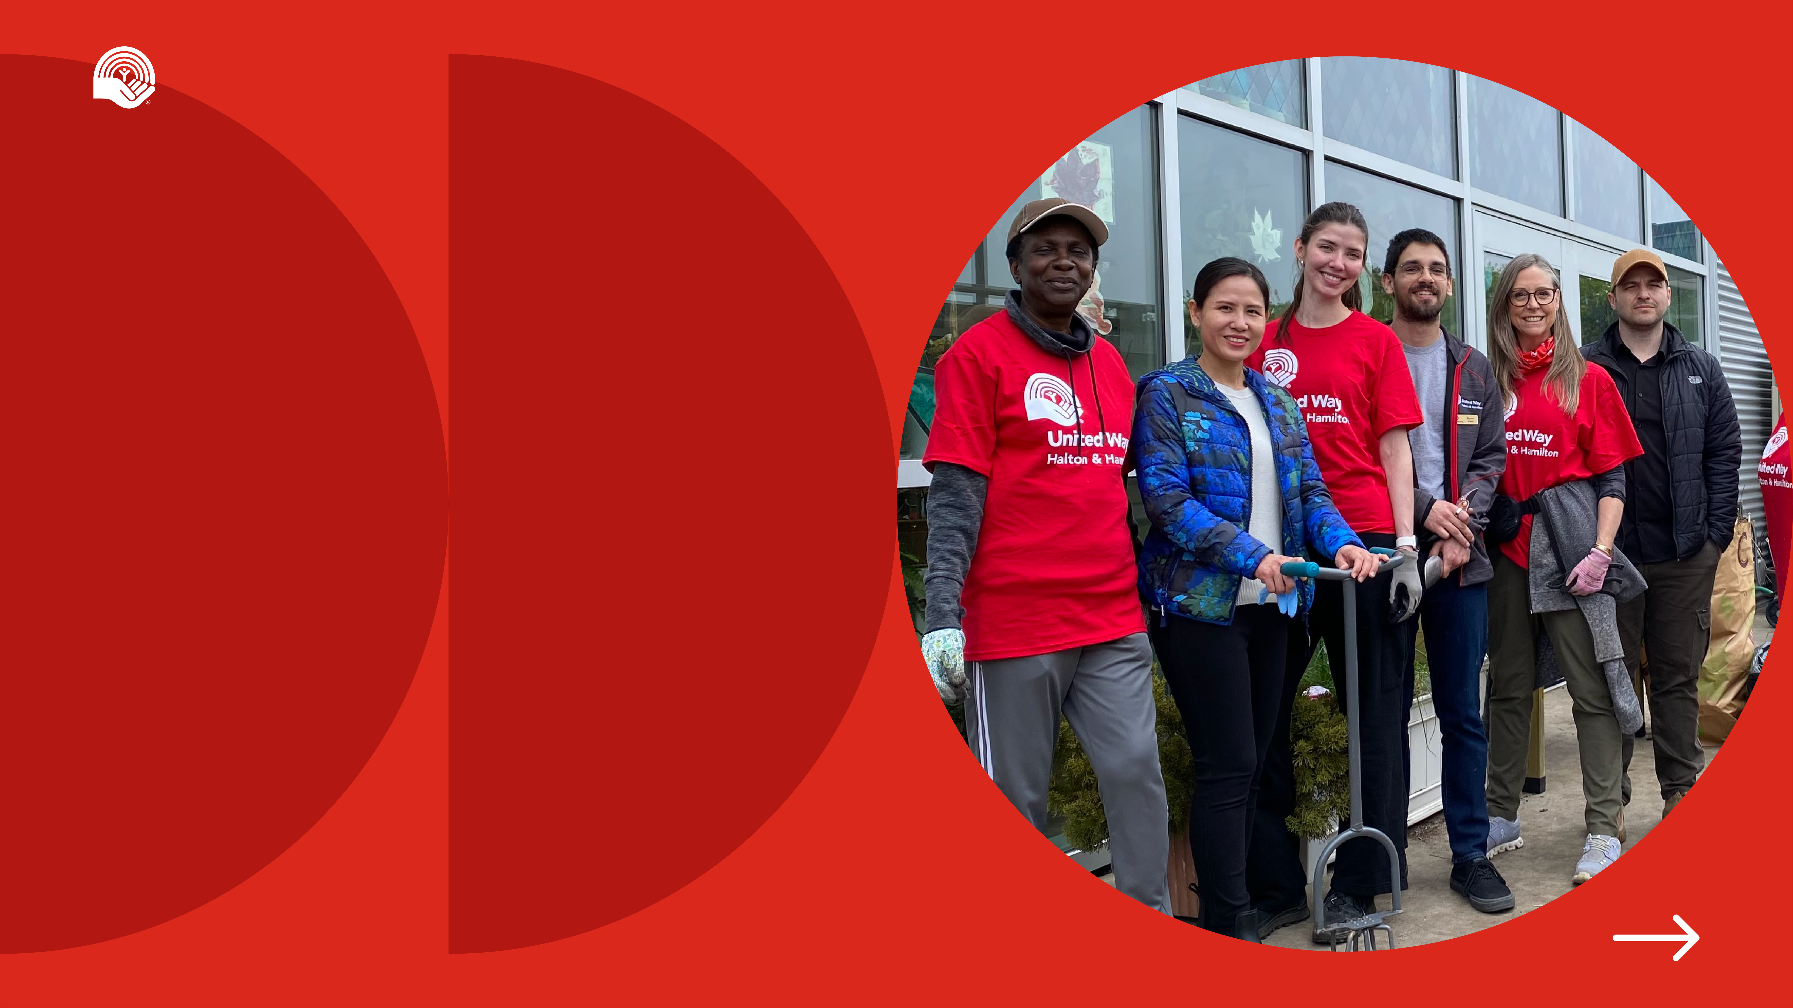
NEW SECTION
TITLE HERE

Slide 36

NEW SECTION
TITLE HERE

